Slide 1
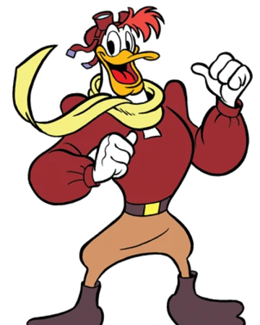
LAUNCHPAD McQUACK AUTONOMOUS DRIVING
Lucas Vanslette, Khurram Malik, Patrick Donelan
Notes:
Hello everyone my name is _ and we made the a lane-following, object detecting duckiebot, the electronic embodiement of launchpad mcquack.

Slide 2
TABLE OF CONTENTS
01 | MOTIVATION
02 | DUCKIEBOT OVERVIEW
03 | ROS IMPLEMENTATION
04 | CAMERA CALIBRATION
05 | LANE FOLLOWING/OBJECT DETECTION
06 | OUR SOLUTION
07 | CHALLENGES FACED
08 | FUTURE GOALS / QUESTIONS
Notes:
Here is our agenda for today, we’ll go over the motivation, a quick duckiebot overview, our implementation of ros, how we calibrated the camera, our solution on how we were able to do lane following and object detection, and we’ll leave some room for questions.

Slide 3
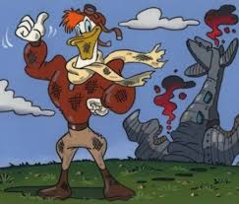
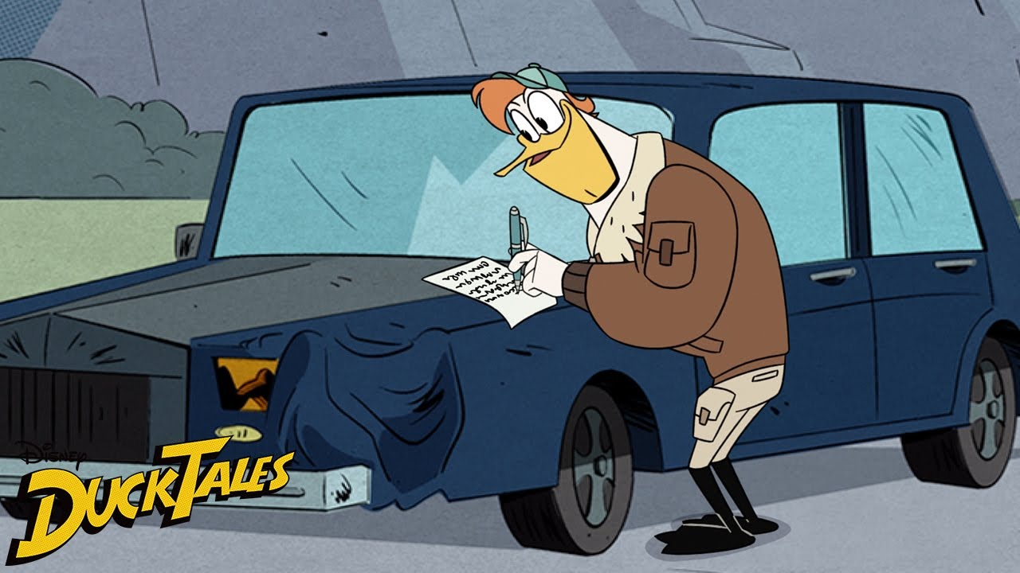
MOTIVATION
Launchpad McQuack is Scrooge McDuck’s personal driver
We named the Duckiebot Launchpad McQuack, hoping to not crash as much...
Notes:
So our motivation for creating a lane-following duckiebot is launchpad mcquack, who if anyone remembers from the cartoons, is the personal driver of scrooge mcduck. We named the duckiebot after Launchpad mcquack and we hoped not to crash as much as him… not sure if we achieved that goal, however...

Slide 4
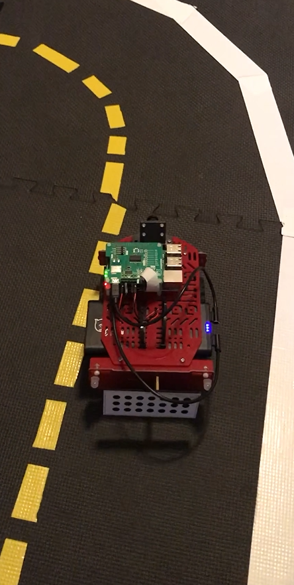
DUCKIEBOT OVERVIEW
Components
2 DC Motors
Motor Hat
Raspberry Pi 3 Model B+
Pi Camera
Notes:
So the duckiebot, AKA Launchpad Mcquack, has two dc motors, a motor hat along with a raspberry pi connected with a picamera

Slide 5
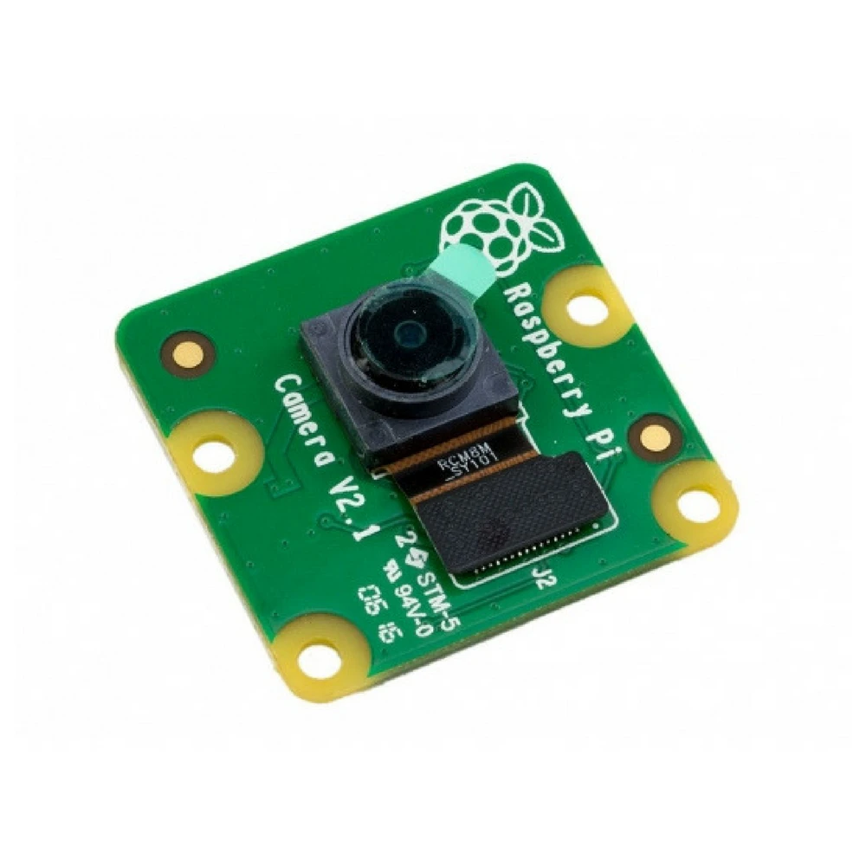
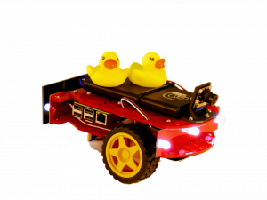
ROS IMPLEMENTATION: CLIENT-SERVICE MODEL
Return snapshot
Camera Interface
Request camera snapshot
Image Processing
Return heading error
Request heading error
Motion Logic
Return linear, angular velocity
Request linear, angular velocity
Motion Interface
Notes:
On the raspberry pi itself, we implemented the client-service model of ROS rather than the publish-subscribe because we wanted to request a camera capture when we wanted a new velocity, rather than the camera giving us images at a certain rate. This gave us the ability to create a node structure that is simple and progressive as seen in the diagram and gives us the ability to control the flow of image data.
Simple, progressive steps
More control

Slide 6
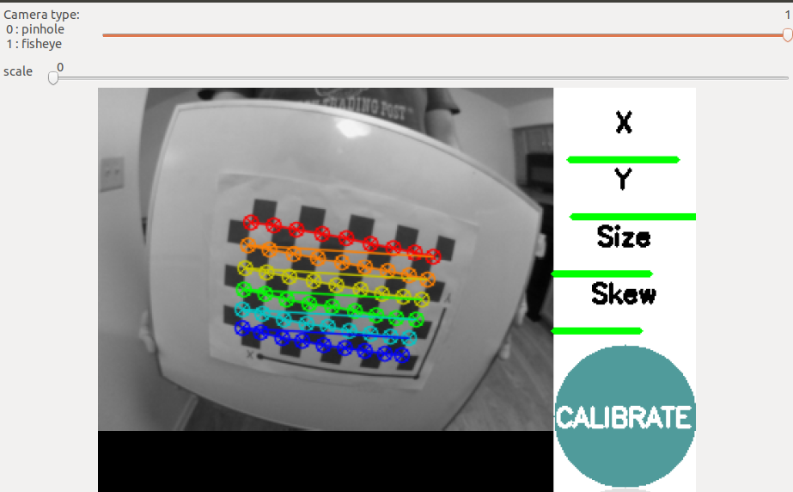
CAMERA CALIBRATION
Used ROS camera calibration to determine intrinsic parameters
We attempted our own calibration with MATLAB and python code first but were not able to get as good of a calibration
Determined the camera extrinsic parameters from the camera pose using MATLAB
Calculated homography matrix using the intrinsic and extrinsic parameters
Notes:
Initially, we tried MATLAB and python code for camera calibration. However, we were not able to get parameters that resulted in reasonable undistorted images and reasonable measurements. So, we decided to use ROS camera calibration. This tool was very convenient as it uses a video stream to collect data vs taking multiple photos only to have the poor ones weeded out, causing you to take more images. The calibrator informs you when enough data has been collected for the X, Y, Size, and Skew to calibrate using color bars. For extrinsic parameters. We used a MATLAB function to convert camera pose into a rotation matrix and a translation vector. The camera pose was estimated by using a ruler and protractor to determine the tilt of the camera as well as its height off the ground. Once we had the intrinsic and extrinsic values, we computed the homography matrix needed for image processing.

Slide 7
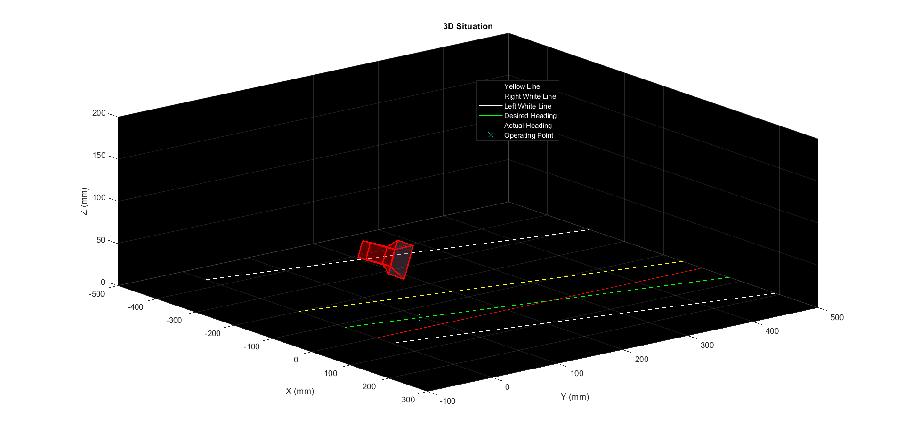
CAMERA CALIBRATION
Notes:
This plot shows the 3D situation of the duckiebot. The white and yellow lines are the road markers, the green line is the desired heading, which is between the yellow and right white line, and the red line is the true heading. As you can see, the camera in this plot is elevated above the lines and tilted downward. This is the camera pose used to determine the extrinsic parameters.

Slide 8
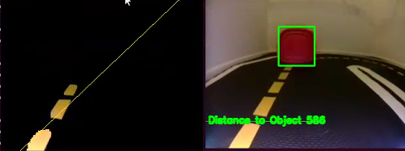
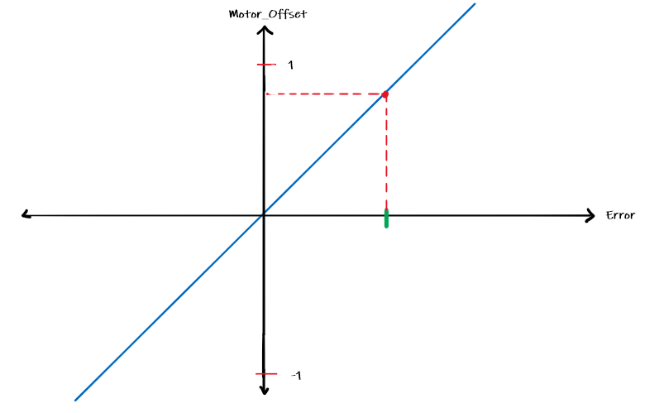
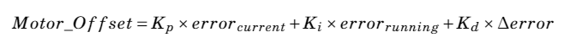
LANE FOLLOWING
Obtain the current frame from the Duckiebot camera
Obtain the error (where we want to be - where we should be)
Obtain the yellow lines from the image
Calculate Motor_Offset from the error
Polyfit based on x,y data points from the yellow lines
Calculate PWM values based on motor_offset for angular velocities
Transform yellow line from image plane to world plane
Add lane offset to yellow line in world plane for desired heading
Notes:
Talk about:
Polyfit 1 vs 2, include pictures of each
Using gain to adjust PWM values so that going out of a turn wasn't so abrupt (smoothing out changes in pwm values)
PID gain to adjust to steady state error (KI) and KP and KD
This is a general outline of how our lane following algorithm works. During each iteration, we obtain a frame from the duckiebot and obtain the yellow lines from the image (see image on top right).
From that image, we transform the yellow points into data points. From the data points, we apply a 1 degree polyfit to obtain a line. Even though 2 degree polyfit served us better in some cases, we found that it overfit the line in certain cases and launchpad mcquack crash. We then transform the line that we created from the image plane to the world plane (aka pixels to mm).
From the new transformed line, we offset the yellow line by a real world distance which will be our desired heading.
To obtain the error, we take the difference between where our duckiebot’s actual heading is and the target heading
Based on that error, we calculate the motor_offset. The motor_offset is used to calculate how much angular velocity to apply to each motor. Our Pwm values are calculated using a linear speed + some angular component. We reserved 75% of pwm bandwidth for the linear component, and the rest for the angular velocity component. The graph on the right illustrates how we calculate the angular component. Based on the error that we see, we essentially obtain the respective motor offset (the y-axis) which ranges from [-1 to 1] or [Turn Left, Turn Right]. Everything in between is some combination.
The motor_offset equation is a PID where we adjust the Kp,Ki,Kd parameters to adjust our steady state error.
After obtaining the motor_offset, we calculate the angular velocities and calculate the pwm values which we send to the robot, but before we send that to the robot, we also decrease the linear velocities based on how high our angular component is. If we have large angular_velocity component, (basically toward the top ends of the graph), we’re in a sharp turn. In order to smooth out the decrease our linear velocity to slow the robot down.
After that, it’s essentially a repeat of all the steps.

Slide 9
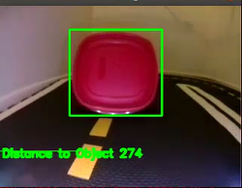
OBJECT DETECTION
Obtain the current frame from the duckiebot
If no objects found, continue with lane following
Obtain any red features from the image
Based on calculated pixel width, calculate real world distance
Filter out any objects that don’t meet a criteria
If the distance calculated is greater than 20 mm, continue with lane following
From the remaining objects, detect the largest object seen in our path
If distance calculated is less than 20 mm stop the robot
Calculate the width in pixels of the object
Notes:
Now i’ll go over how we did our object detection.
Similar to the lane following, we get a image frame from the duckiebot and find any red features in the image. We do something filtering to get objects that don’t meet our critera. From the reminaing images, we detect the largest object that’s in our path
From that object we calculate the width of the object in pixels. From that pixel value, we apply a transformation using the focal length of the camera to calculate a real world distance. The image on the top right shows what our output looks like. Once we obtain the distance, we check if we’re less than 20 mm away from the object, if so stop the robot. If not, we continue with our lane following algorithm.
On the next slide, we’ll show our results.

Slide 10

OUR RESULTS
Notes:
The video on the left demonstrates our lane following algorithm. The next video shows the object detection

Slide 11
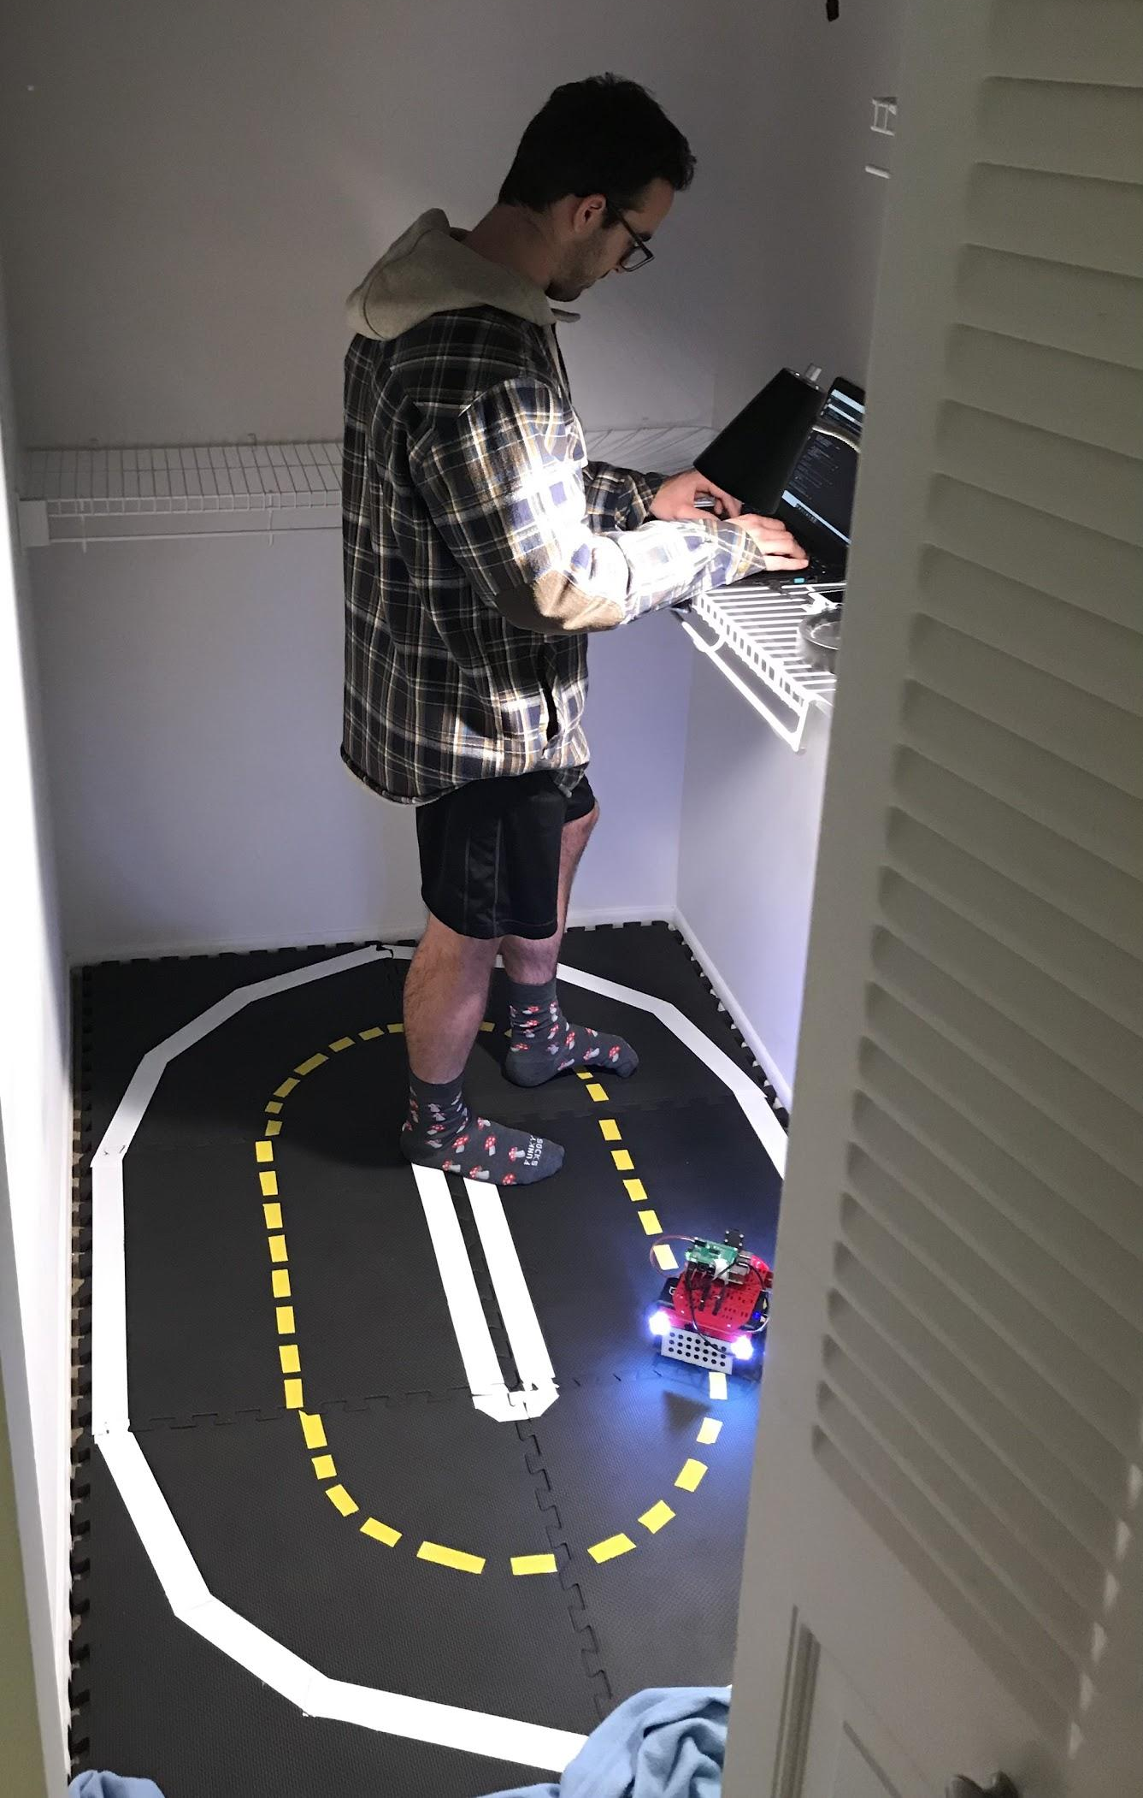
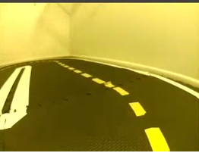
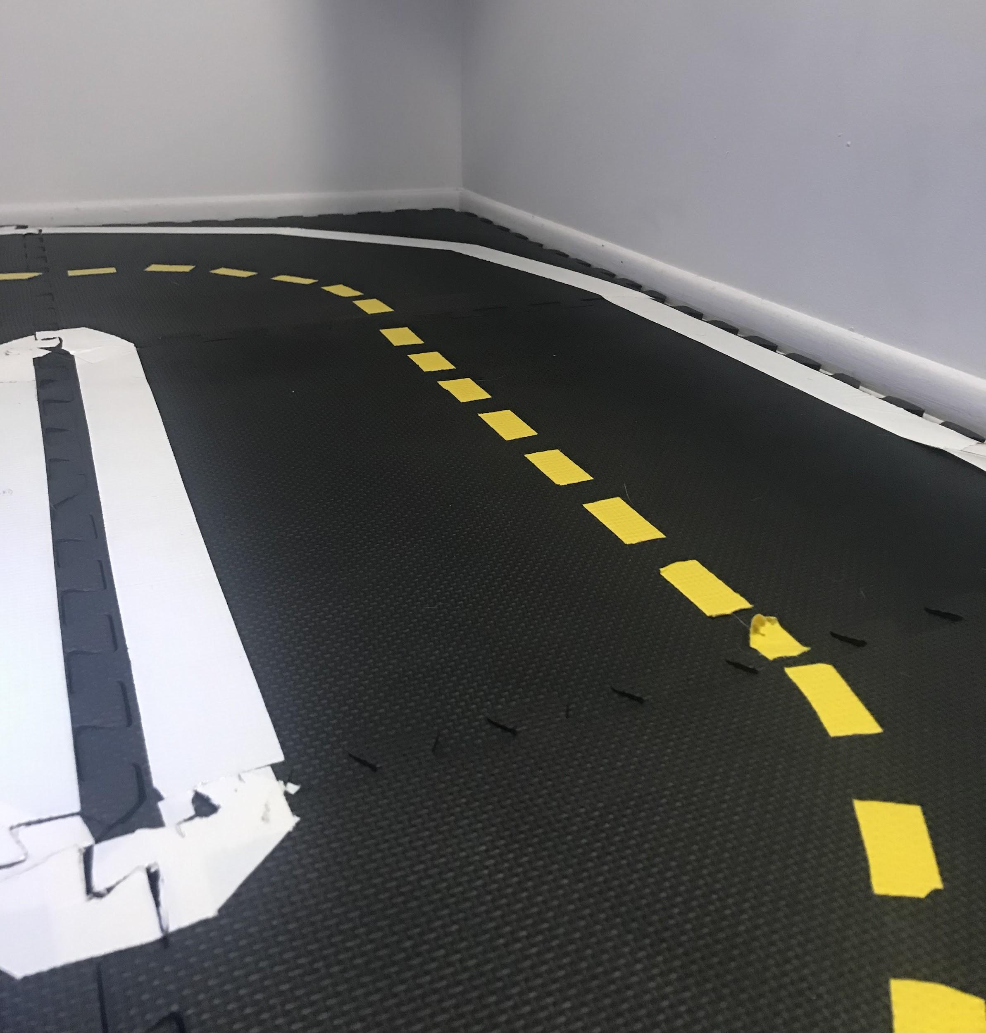
CHALLENGES FACED
Color masking
Different lighting conditions would give a yellow hue to our image.
Resulted in artifacts in yellow image extraction which would throw off our line following algorithm
Moved to closet for a controlled color environment
Should be white, yellow instead
Notes:
Despite being able to get lane following to work as well as object detection, our progress was hindered by factors such as environment lighting. Whenever we picked back up on the project we would have to re-calculate the Hue-Saturation-Value parameters in order for the duckiebot to recognize the yellow line. We eventually moved the track to a closet so that we could have consistent lighting.

Slide 12
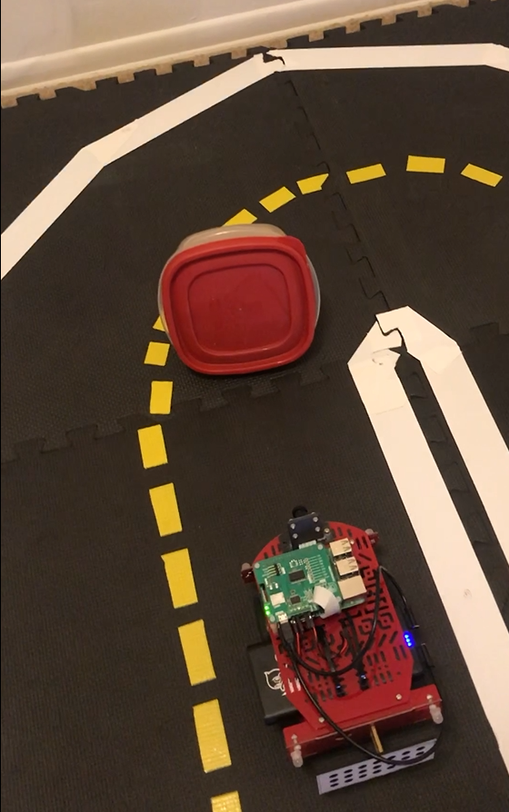
FUTURE GOALS
More robust lane following
Object avoidance path planning
Different obstacle avoidance schemes for obstacles of different colors
Notes:
Currently, lane following is inconsistent and needs to be made more robust. We can go from a really good run to a poor run back-to-back. We would like our solution to work for different track styles and lighting conditions. Additionally, we would like to add obstacle avoidance path planning so the duckiebot can continue moving versus stopping when an object is detected. We would like to further expand on this idea by implementing different obstacle avoidance schemes for objects of different colors.

Slide 13
End
Any Questions?
Notes:
Any questions??????

